Slide 1
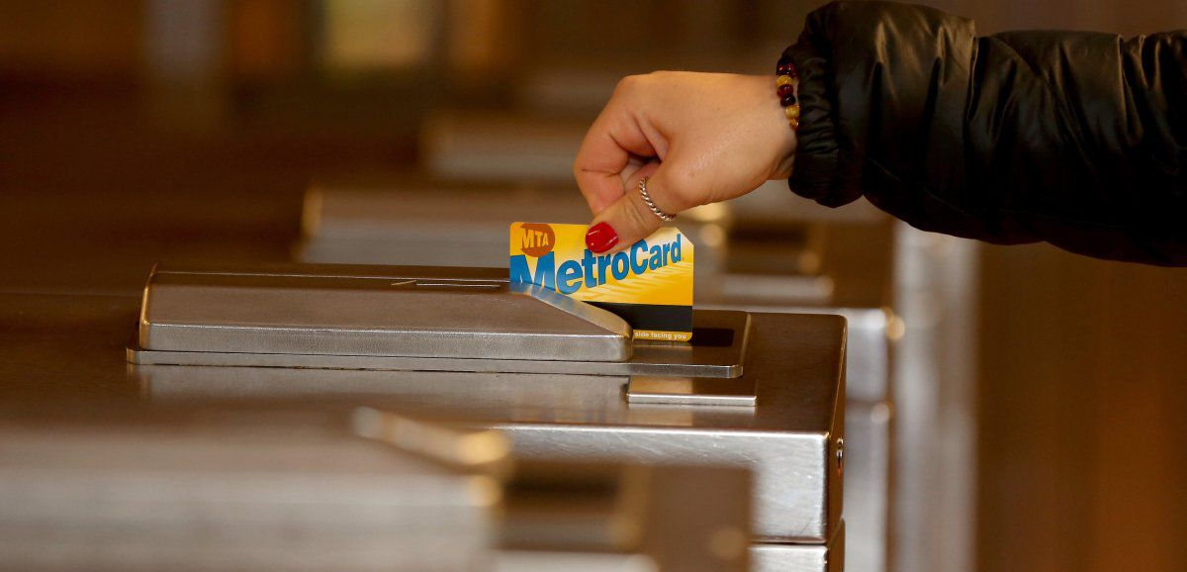
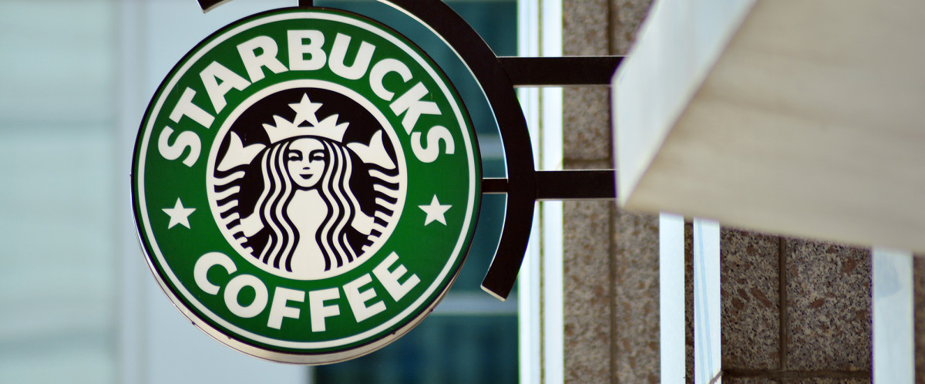
MTA X Starbucks Capstone
Gregory Rankel

Slide 2


Agenda
Problem Statement
Overview
Starbucks
E line
Data Collection
Data Cleaning
Expletory Data Analysis (EDA)
Case #1: Port Authority:
EDA
Model Selection
Model Evaluation
Case # 2: Jackson Heights
EDA
Model Selection
Evaluation
Conclusion

Slide 3
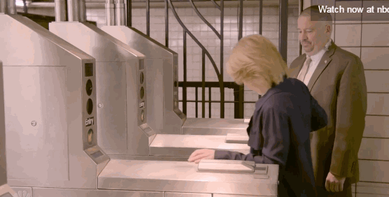
Problem Statement
-Starbucks looking for possible expansion opportunities
- Turnstile can be a means of possibly determining foot traffic within an area
- Can we build a model that will beat the average turnstile data accumulated throughout the year?
- Models: ARIMA and SARIMA
- Metric: RMSE

Slide 4
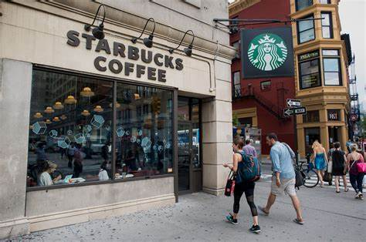
Starbucks
International Franchise 30,000 locations and growing
Over 240 Stores located within the area
NYC is top two coffee consumption city in the United States (Seattle)

Slide 5
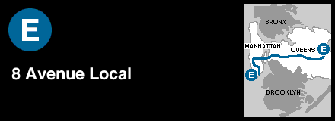
MTA E Line Overview
Station that runs through Downtown Manhattan all the way to Jamaica Queens
Stops at Major transit stations
Port Authority
Penn Station
AirTran to JFK
31 Total Stops with stations that are also:
Full Time
Part Time
Late Night Service

Slide 6
Data Collection & Cleaning
Starbucks Location
Station Location
Station Turnstiles
Merged Data Frame

Slide 7
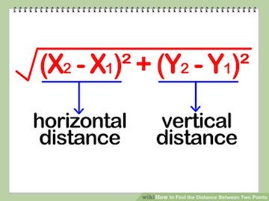
Calculating Distance
- X represents Latitude
- Y represents Longitude

Slide 8
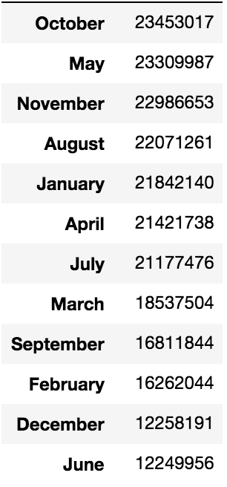
EDA – Total Turns per Month

Slide 9
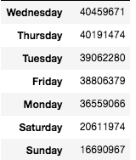
EDA –Total Turns per Day of Week

Slide 10
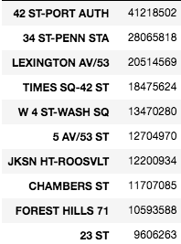
EDA –Total Turns by Station
Top Ten

Slide 11
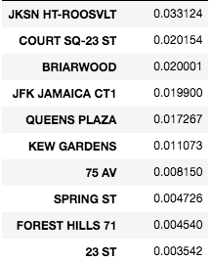
EDA- Starbucks Distance
Top Ten

Slide 12
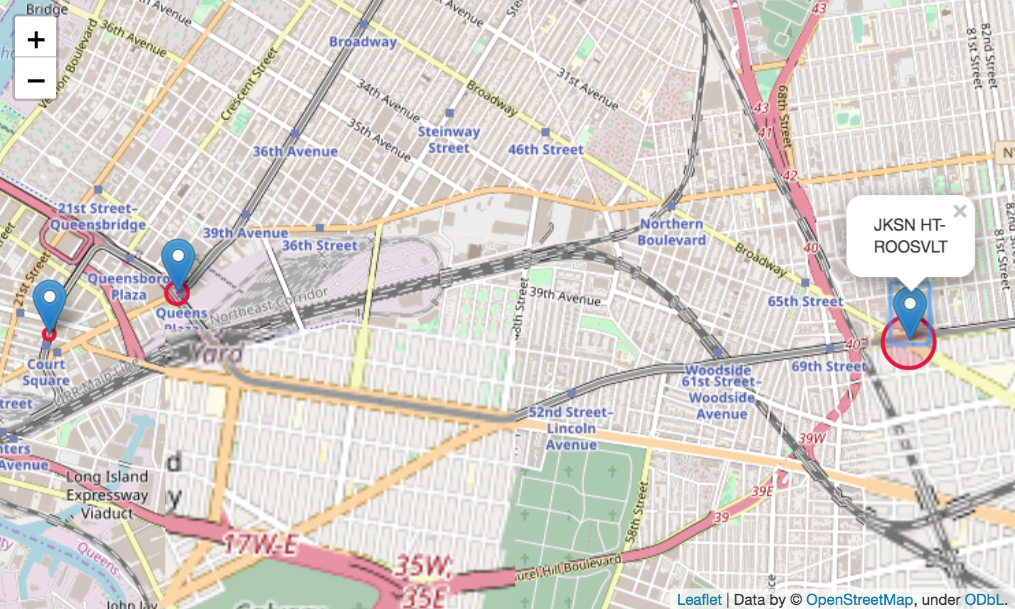
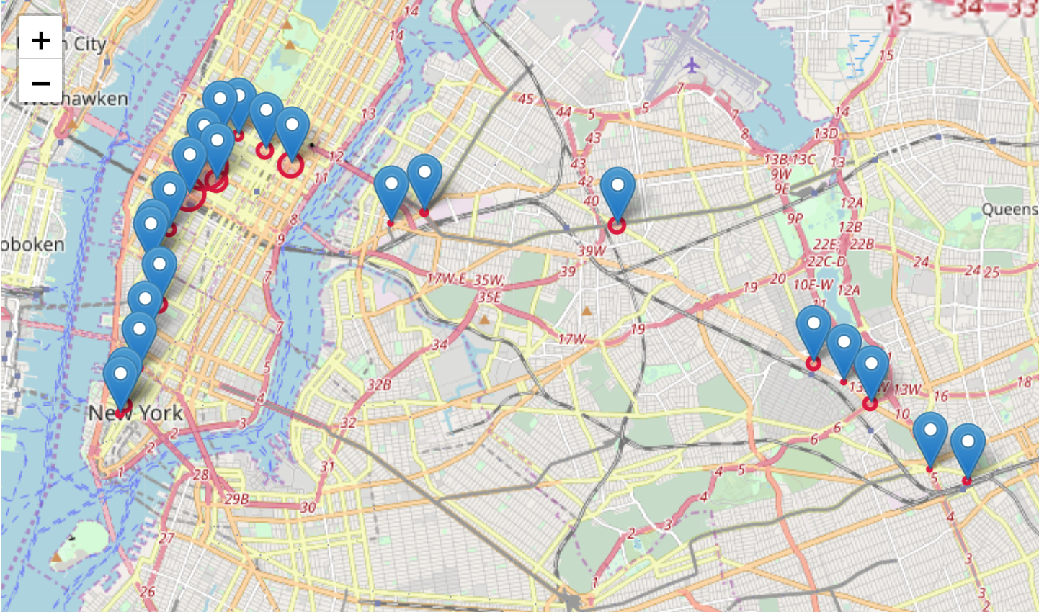
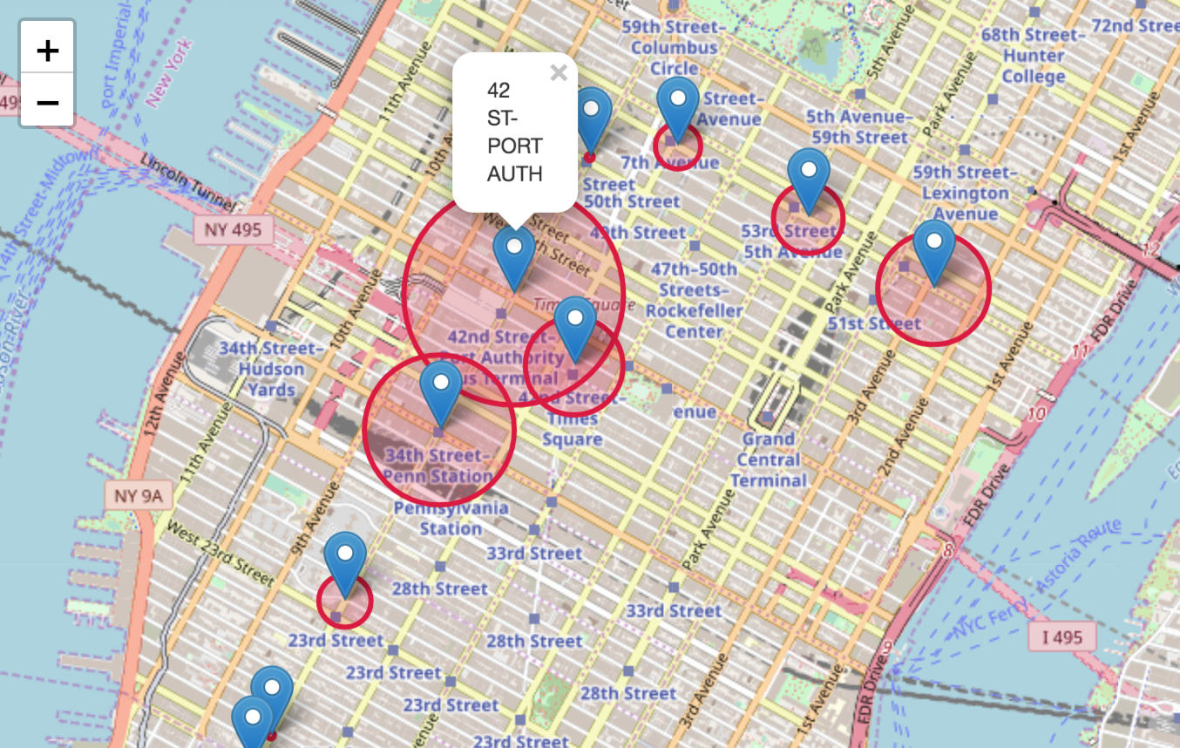
EDA – Stations Map

Slide 13
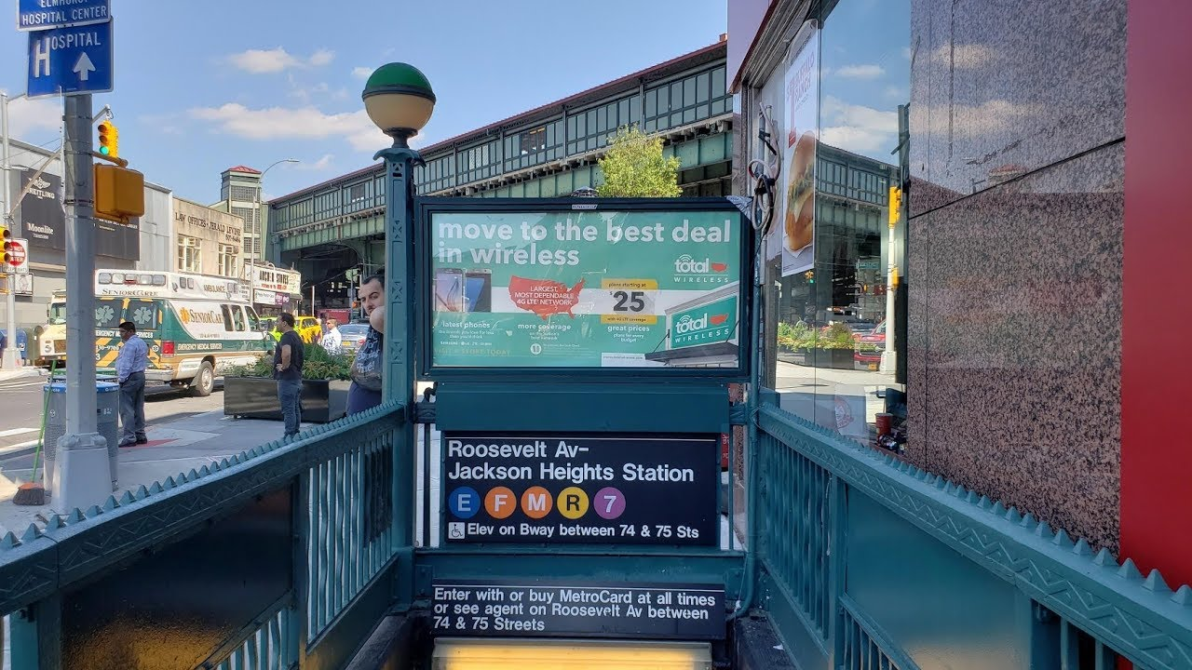
Case Studies
42nd St Port Authority
Roosevelt Av -Jackson Heights

Slide 14
Port Authority EDA: Total Turns- Daily
?

Slide 15
Outlier Points
March 2017 North American blizzard
Not Dropped: Part of yearly cycle that should be accounted for
2017 New York City attempted bombing
Dropped: Threat that is out of everyday cycle

Slide 16
Port Authority EDA: Total Turns – Monthly and Quarter Average

Slide 17
Port Authority Model: Preparation
Augmented Dickey-Fuller Test | Score
P-Value | 0.000094

Slide 18
Port Authority Model: Selection
Model | RMSE
Baseline | 31,979.67
ARIMA (6, 0, 6) | 15,420.69
SARIMA (6, 0, 6) x (1,0,1, 7) | 15,362.62

Slide 19
Port Authority Model Evaluation: Residuals
?
Thanksgiving

Slide 20
Port Authority Model Evaluation: Actual vs Predicted

Slide 21
Port Authority Model Evaluation: Train, Test, Future Predictions

Slide 22
Port Authority Model Evaluation: Test and Predictions

Slide 23
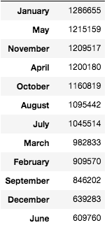
Jackson Heights EDA – Total Turns per Month

Slide 24
Jackson Heights EDA: Total Turns – Monthly and Quarter Average

Slide 25
Jackson Heights Model: Preparation
Augmented Dickey-Fuller Test | Score
P-Value (Diff = 0) | 0.337640
P-Value (Diff = 1) | 3.083631e-18

Slide 26
Jackson Heights Model: Selection
Model | RMSE
Baseline | 8,230.19
ARIMA (6, 1, 4) | 40, 156.61
SARIMA (6, 1,4) x (3,1, 2, 7) | 3,451.22

Slide 27
Jackson Heights Model Evaluation: Residuals
Thanksgiving

Slide 28
Jackson Heights Model Evaluation: Actual vs Predicted

Slide 29
Jackson Heights Model Evaluation: Train, Test, Future Predictions

Slide 30
Jackson Heights Model Evaluation: Test and Predictions

Slide 31
Conclusion and Recommendation
Successfully built a model that beat the average turnstiles of a station even if it is limited
We do have an opportunity for Starbucks to look into further and see about possible expansion
Need more data:
Weather
More years
Test over other seasons to see if similar trends will continue
Test on other high turnstile stations to see if same results as well as low end to see if similar

Slide 32

Questions

